Slide 1
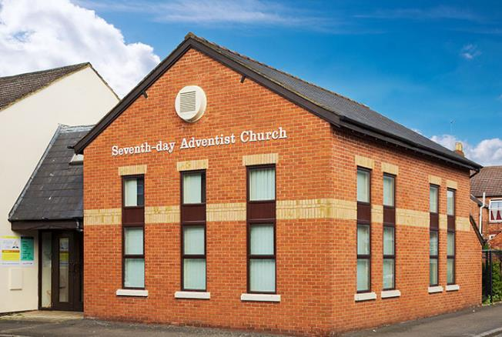
This is a template & tutorial with recommendations on creating your next presentation for Kettering SDA Church.

Slide 2
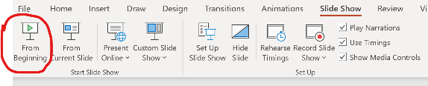
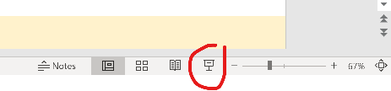
Please use this template for correct settings in your next presentation. (You can delete these slides and start again.)
Firstly, to know how to make the best presentation for the church please start this PowerPoint. If you are not sure how, please follow the below instructions:
Please start this presentation by holding down “fn” + pressing “f5” keys
Alternatively go to Slide Show and select “From Beginning” , the same icon can be found in the bottom right of the window
Continue to click your mouse or use the left and right arrows on your keyboard to bring up the next point until the end of the presentation

Slide 3
Please ensure the following for your presentation: TEXT
Verdana or Calibri font for all text
Verdana text size should be no smaller than 20pt (this is 20pt)
Calibri text size should be no smaller than 28pt (as this)
Keep your text to short bullet points where possible
For Bible texts, ensure clearly defined verse numbers
Use points as cues and support to your presentation, not as a script. (unless bible texts)
With bible texts do not try to cram a large reading onto one slide. Instead spread verses across multiple slides to ensure easy reading from the congregation. Make sure you credit the Bible you have taken the text from and the year of publication (on every slide of excerpts).

Slide 4
Please ensure the following for your presentation:
Margins
Try and keep any text within a perimeter as seen as the red line on this slide.
This keeps any text from being hard to read as it becomes near to the edge of the screen.

Slide 5
Please ensure the following for your presentation:
Colour
To make this accessible to everyone it is important to keep your colour palette simple.
Use differentiating colours between the text and the background. Remember, some people are colour blind so think of darkest shades on light. E.g. this Dark Navy or dark green on white.
Please avoid using black background unless the text is clear, at least 30pt in size and bolded in white. Dark Navy is a good alternative as it gives less glare. This is only really recommended for headings or short quotes/verses.
Such as this example
You can also use a soft pale background as the one on this template. This helps viewers who suffer from glare when reading black text on white backgrounds. e

Slide 6
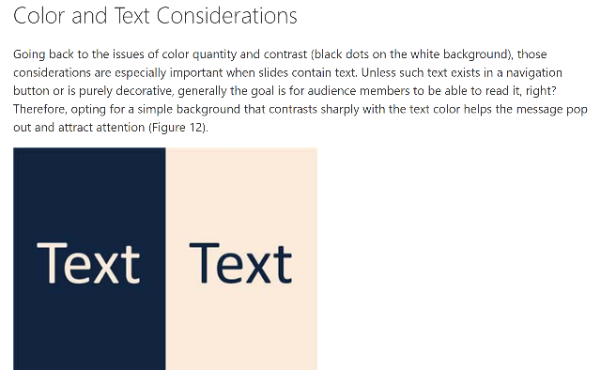
Please ensure the following for your presentation:
Colour
See the excerpt below from Microsoft office advice on presentation text to background colours:
To read the full advice article please follow this link: https://support.office.com/en-us/article/combining-colors-in-powerpoint-%E2%80%93-mistakes-to-avoid-555e1689-85a7-4b2e-aa89-db5270528852

Slide 7
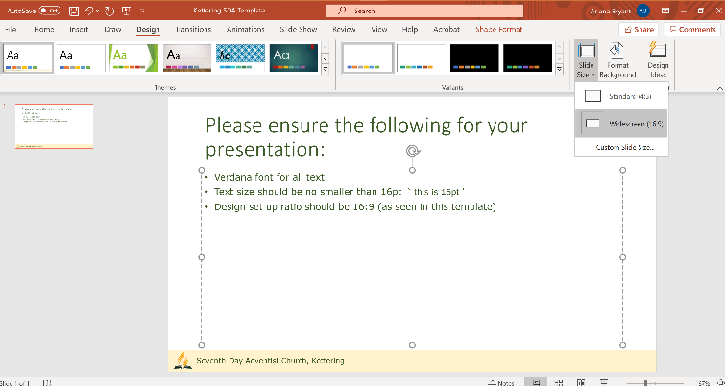
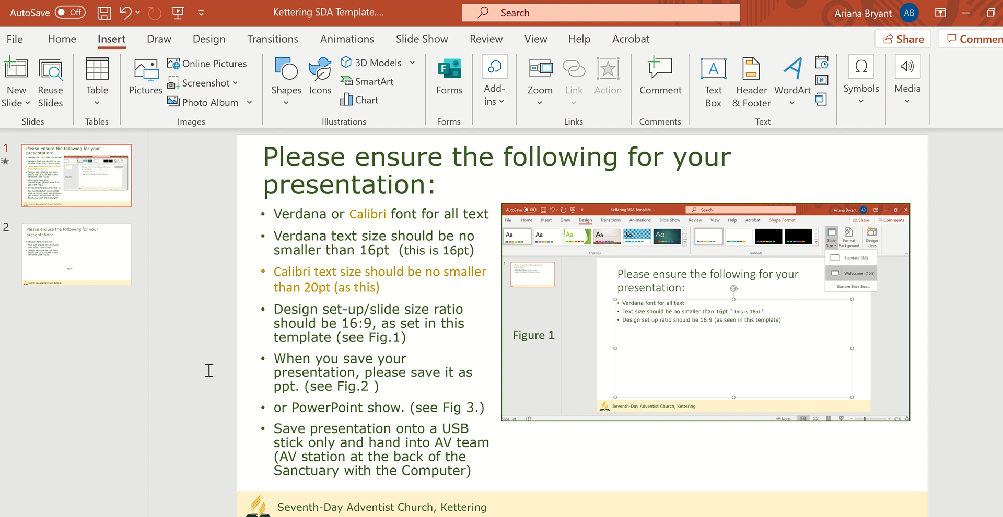
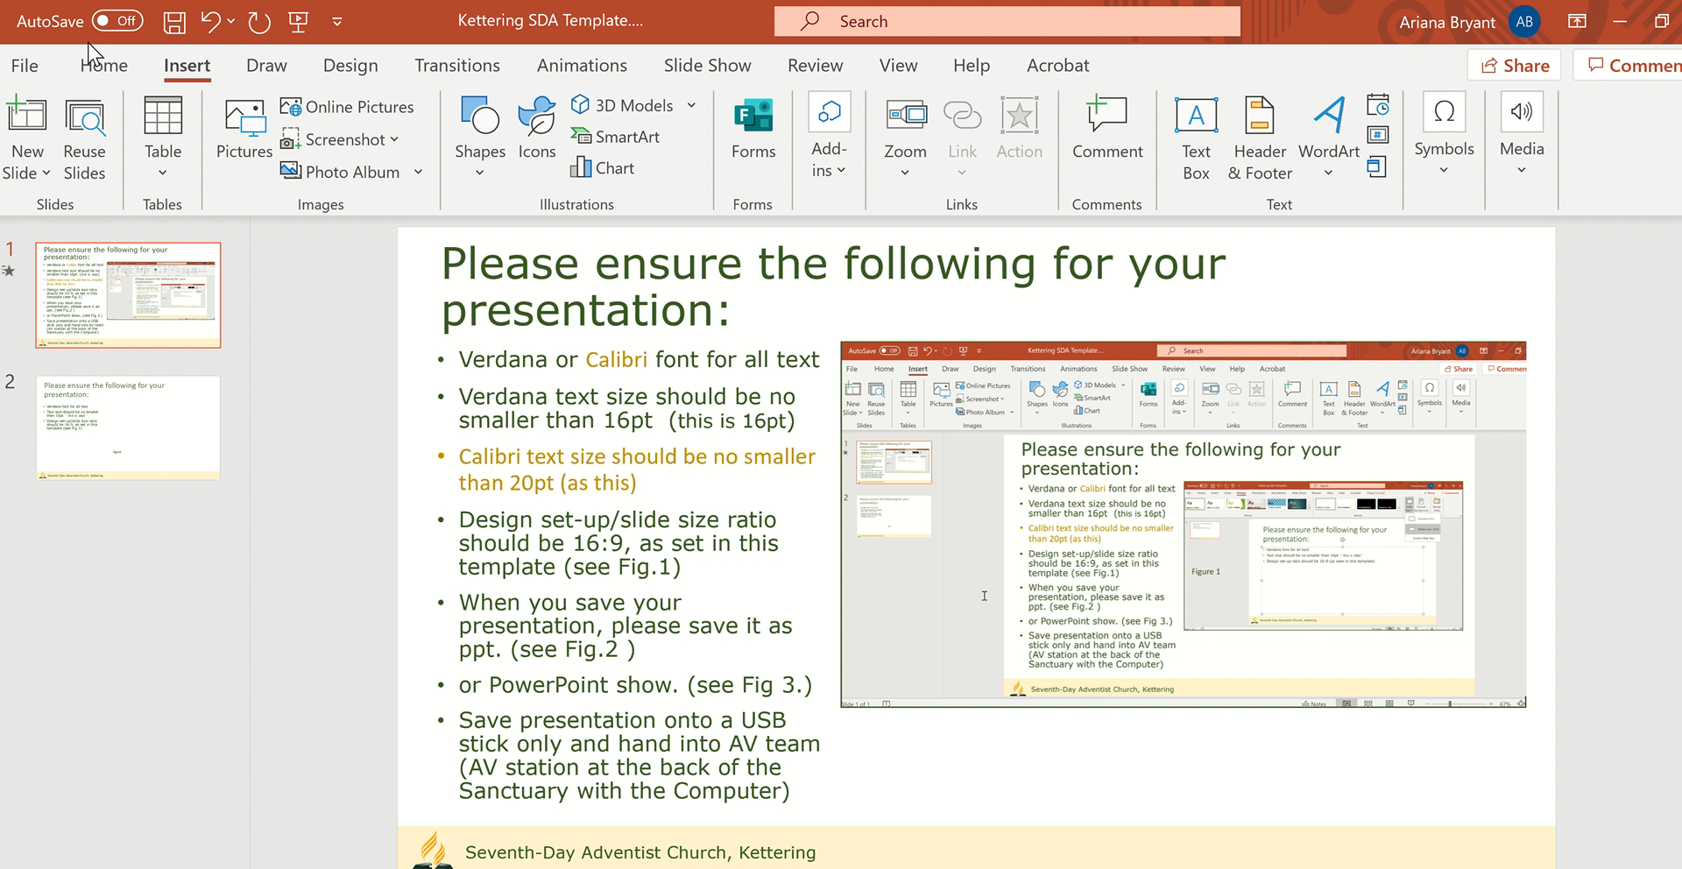
Please ensure the following for your presentation:
Design set-up/slide size ratio should be 16:9, as set in this template (see Fig.1)
When you save your presentation, please save it as .pptx (see video 1, click image to start )
or PowerPoint show: .ppsx (see see video 2, click image to start )
Save presentation onto a USB stick only and hand into AV team (AV station at the back of the Sanctuary with the Computer)
Video 1
Figure 1
Video 2

Slide 8
Thank you for taking the time to review these recommendations.
The Kettering AV Team & congregation look forward to your next presentation ☺
If you would like to know how to do more with your presentations, for example, adding animations or how to use images in a viewer friendly way and anything else, please do not hesitate to get in touch.
If you require a video or soundtrack to be played as part of your service please contact the AV Team 3 days before your presentation/special item.
Contact: Ariana Bryant - ariana.bryant@gmail.com please give your name, church and the service/audience you wish you to present to.

